Slide 1
Notetaking in MySuccess
For Academic Advisors
Produced by Holly Perry

Slide 2
Notes with information & content that allows you or another advisor to understand what was previously discussed, decided, and done. Allowing future meetings to pick up where you left off.
Very Helpful:

Slide 3
Very Helpful

Slide 4
Very Helpful + Speed Notes

Slide 5
Very Helpful

Slide 6
Very Helpful + Speednotes

Slide 7
Very Helpful + Speednotes

Slide 8
Very Helpful

Slide 9
Very Helpful

Slide 10
Very Helpful

Slide 11
Very Helpful

Slide 12
Very Helpful+ Speednotes

Slide 13
Very Helpful

Slide 14
Very Helpful

Slide 15
Very Helpful

Slide 16
Notes with information & content that leave you unsure what was previously discussed, decided, and done. These notes typically leave you asking additional questions as you read them.
Less Helpful:

Slide 17
Less Helpful

Slide 18
Less Helpful

Slide 19
Less Helpful X’s Two

Slide 20
Less Helpful

Slide 21
Less Helpful

Slide 22
Notes with little to no useful information & content. These notes typically leave you asking…. “What???” Keep in mind, abbreviations or acronyms might not be understood by all.
Not Very Helpful, Let’s Improve!:

Slide 23
Not Very Helpful, Let’s Improve!

Slide 24
Not Very Helpful, Let’s Improve!

Slide 25
Not Very Helpful, Let’s Improve!

Slide 26
Not Very Helpful, Let’s Improve! X’s Two

Slide 27
Not Very Helpful, Let’s Improve!

Slide 28
Consequence of poor notes within MySuccess
From: Lee Martinez <Lee.Martinez@slcc.edu> Sent: Wednesday, February 12, 2020 7:13 PM Subject: Student appointments and notes
As I mentioned to you, we denied a student’s application for funding in today’s SAP appeal meeting. One of the main reasons was there was no justification as to why the student was taking certain classes and some members on the committee didn’t understand why he was doing what he was planning in light of his academic difficulties. A pink SAP Appeals form was submitted with your name on it, but there were no notes for this student in MySuccess.

Slide 29
Example of How often some students choose to see an advisor…. Note the dates and locations of these meetings

Slide 30
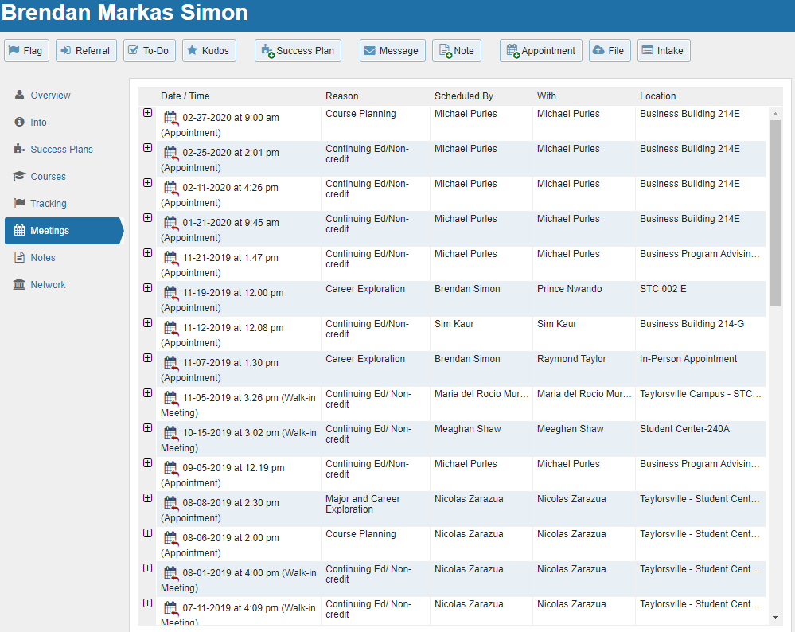

Slide 31
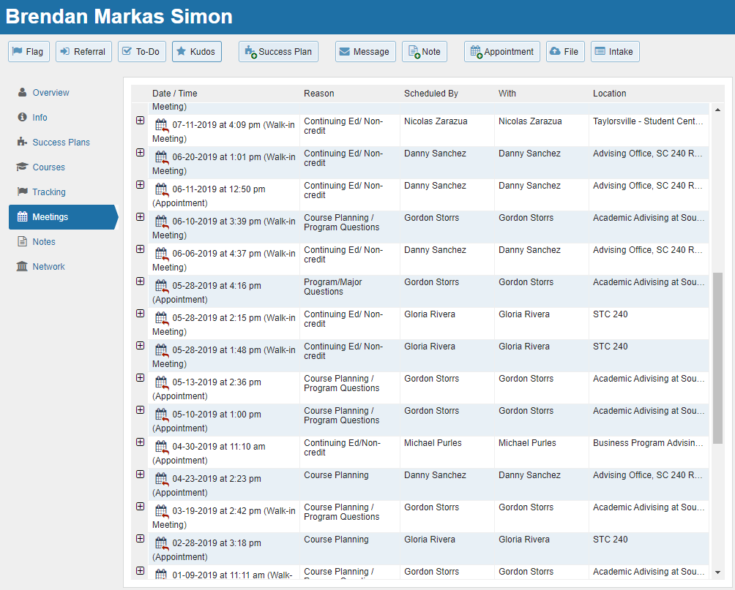

Slide 32
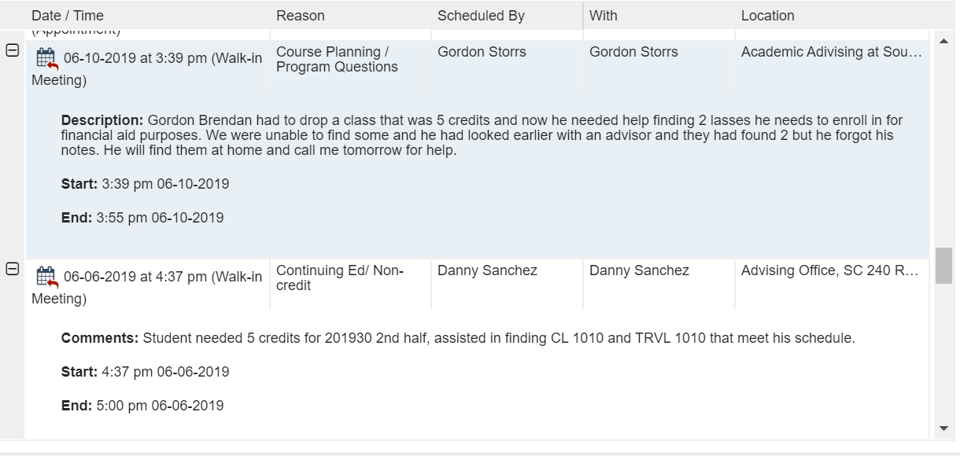

Slide 33
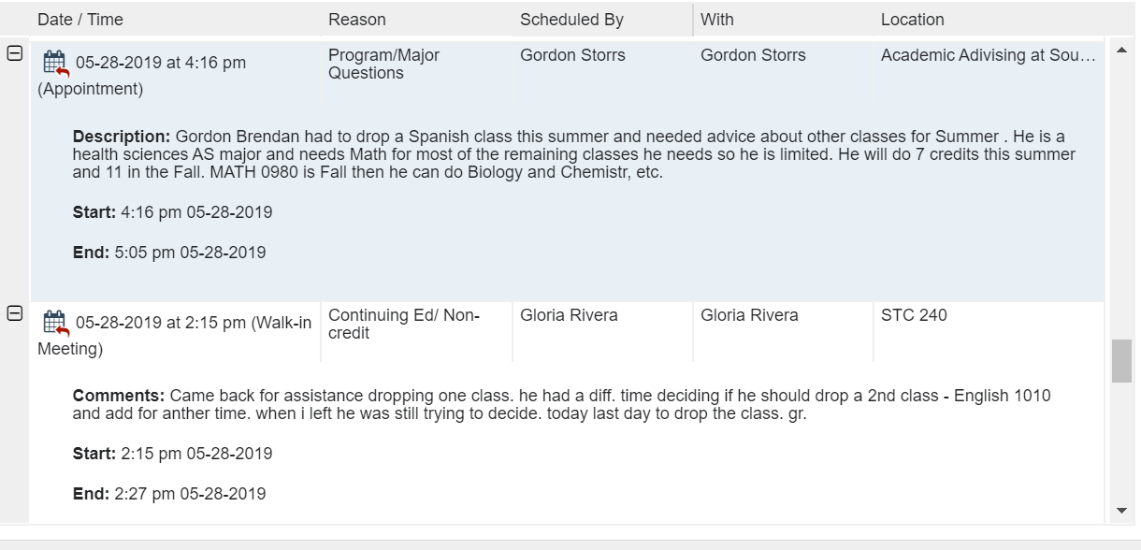

Slide 34
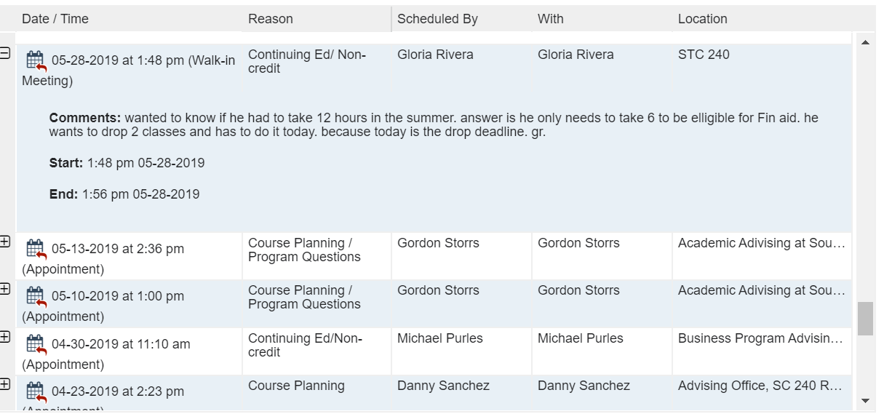

Slide 35
Guidelines for Advising Notes:
Include notes that will help the student.
Include notes that will help future advisors understand the student or the advice that you gave.
Include list of courses approved, along with alternatives.
Include notes that will facilitate the relationship with the student.
Include possible consequences of not following advice given.
Include referrals of a non-sensitive nature.
Include comments that help you in future interactions with student. (Perhaps in helping students with reference letters or scholarship applications.)
Exclude your subjective judgments about the student, especially when they are negative. (In some cases, you may wish to use personal files. In most cases, should probably omit altogether.)
Exclude referrals of a sensitive or personal nature. (May wish to use personal notes.)
Exclude comments regarding student’s instructors, especially when they are negative. (May wish to use personal notes.)
Exclude personal concerns of the student. (May wish to use personal notes.)
Product of Missouri State Academic Advising and Transfer Center

Slide 36
Advising Notes: Do’s and Don’ts
Product of Missouri State Academic Advising and Transfer Center

Slide 37
Advising Notes: Do’s and Don’ts
IN GENERAL:
• If in doubt, leave it out.
• If appropriate, ask student’s preference and note that you have done that.
• Describe, do not evaluate.
Product of Missouri State Academic Advising and Transfer Center

