Slide 2
I want to learn more about Justice, Equity & Diversity Inclusion.
Where can I start?
Notes:
I want to learn more about Justice, Equity Diversity & Inclusion (JEDI). Where can I start?
Staff Development coordinates a lot of training in Justice Equity Diversity and Inclusion with our campus partners. We also have a new Coordinator for Equity, Diversity and Inclusion named Cha McNeil. This presentation will help provide some resources for you as you work on your GPS and development plans this year.

Slide 3
Set Goals in your GPS
Understand the basics of accessibility and why it matters.
Join a learning circle to deepen your awareness about identity.
Participate in SLCC Serves and move outside of your comfort zone.
Join the SLCC & YWCA 21 Day Challenge on Racial Equity and Social Justice Challenge.
Notes:
Set Goals in your GPS to learn, grow and develop your skills in equity work.

Slide 4
Set Goals in your GPS
Put yourself in someone else’s shoes (job shadow or job swap). ​
Attend a Wellness Lecture Series to develop your understanding of how complex factors of where individuals are born and live can impact their health.​
Gain confidence in entering conversations about race and inequity.
Notes:
You will need to work with your supervisor to make these SMART goals and include the timeframe for instance for when you want to work on achieving these goals.

Slide 5
Universal Access
Clint Stoker
Coordinator, Universal Access

Slide 6
Universal Access
Universal Access Core Training (Online)
Learn the basics
Apply what you've learned
UA Teaching Circle
Meet faculty and staff engaged in accessibility
Explore complex issues

Slide 7
Wellness Program
https://i.slcc.edu/hr/wellness/index.aspx
Notes:
Many disparities in health are rooted in inequities and in the opportunities and resources needed to be as healthy as possible. The determinants of health include living and working conditions, education, income, neighborhood characteristic, social inclusion, and medical care.
Across the nation, gaps in health are large, persistent and increasing—many of them caused by barriers set up at all levels of our society. Health equity means increasing opportunities for everyone, especially groups that have been excluded or marginalized in the past, to live the healthiest life possible, no matter who we are, where we live, or how much money we make.

Slide 8
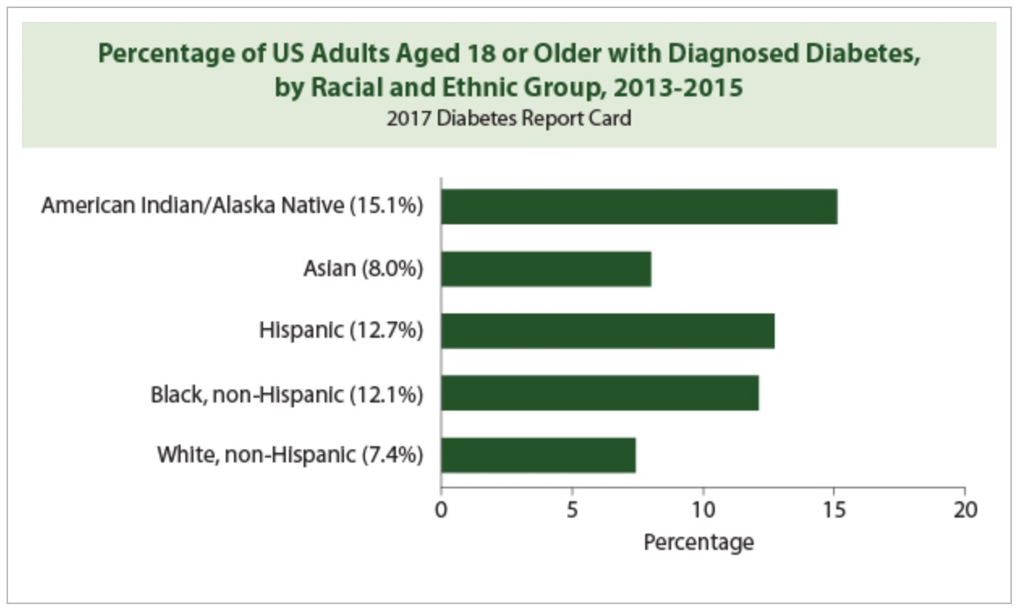
Closing the Gap of Health Disparities
Notes:
The Employee Wellness Program is striving to shrink the health disparities gap in our SLCC community through the CDC's National Diabetes Prevention (known as NDDP) along with many other programs and initiatives that we offer to employees.
Over 88 million American adults have prediabetes – that’s 1 in 3 adults! Of those 88 million, more than 8 in 10 of them don’t even know they have it. Without taking action, many people with prediabetes could develop type 2 diabetes within 5 years.
Some groups of people are affected by prediabetes and diabetes more than other groups.
African Americans, Hispanic/Latino Americans, American Indians, Pacific Islanders, and some Asian Americans are at particularly high risk for type 2 diabetes. The CDC developed program that has shown to reduce the onset of diabetes among individuals identified as pre-diabetic by 58%. I am proud of our Wellness Team and their award winning programming efforts for our employees.

Slide 9
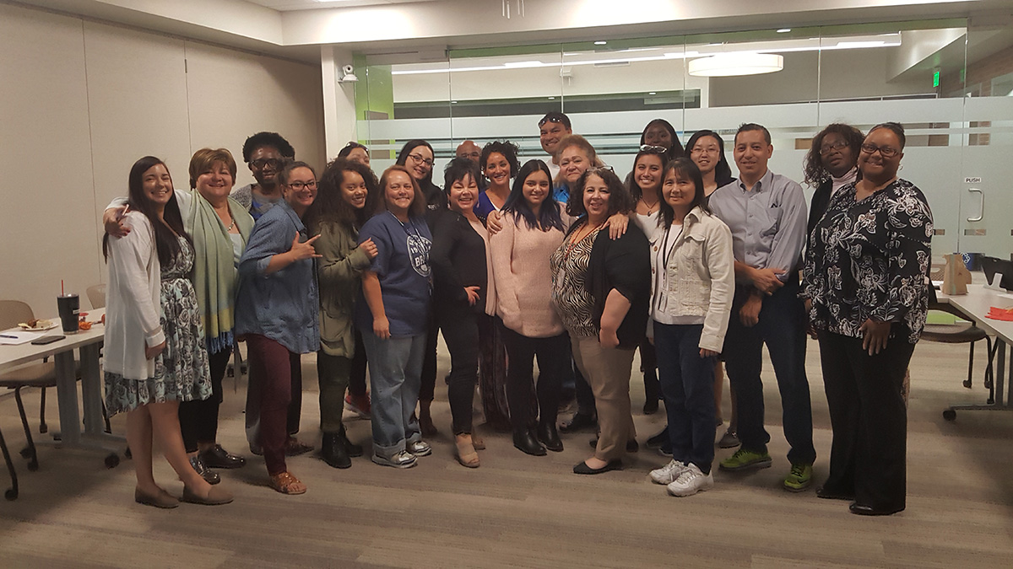
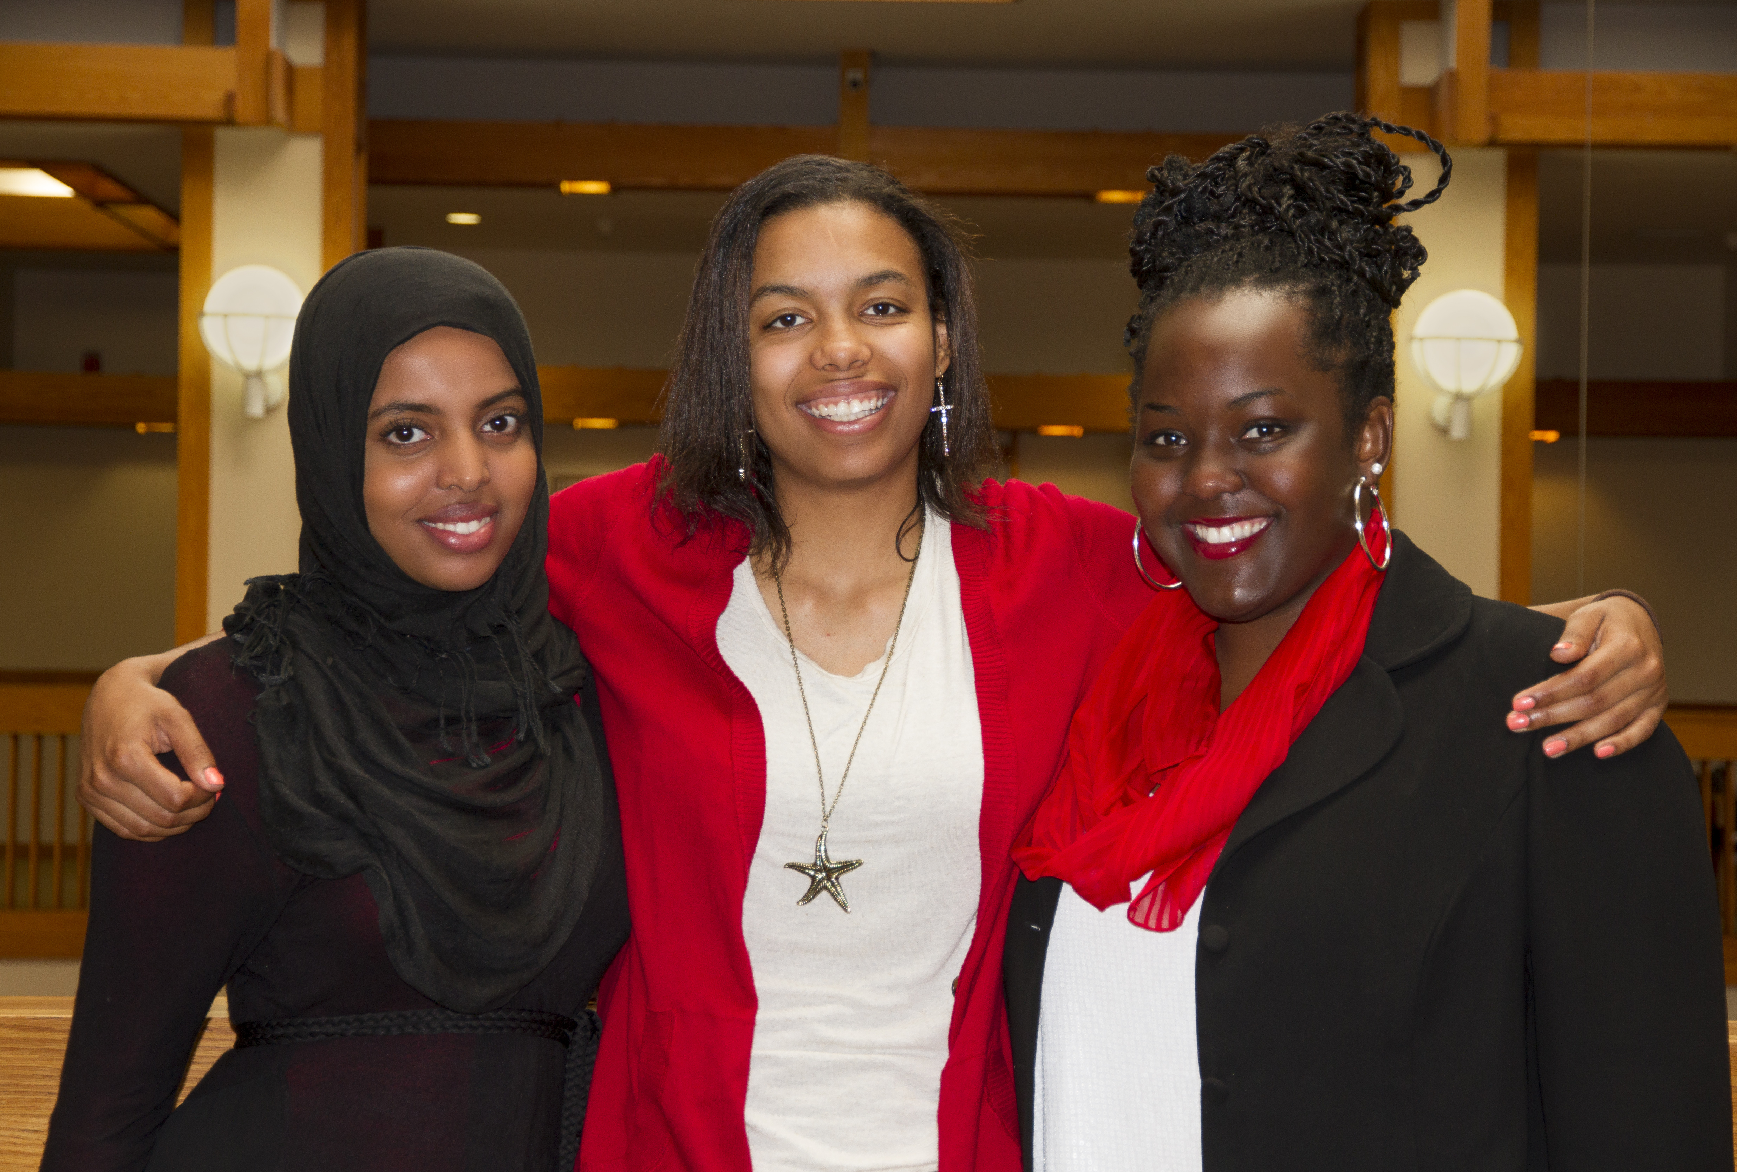
Employee Resource Groups
Notes:
You can also get engaged with Employee Resource Groups (ERGs) to learn more about other cultures, languages, and increase your understanding of what the experiences are like for underrepresented groups. ERGs are an effort to provide a voice and help our colleagues feel included and valued at SLCC.
Staff Association- The purpose of the Staff Association is to advocate on behalf of all full-time, and part-time Staff to promote the growth, development, and engagement of its members, to highlight staff accomplishments, and to work with all departments to create an inclusive environment while supporting the mission of the College and its strategic priorities.
Ethnic Minority Employee Coalition (EMEC)- Seeks to promote inclusiveness of underrepresented employees at SLCC.
Utah Women in Higher Education Network (UWHEN)- To create an environment of collective empowerment for all women working in higher education at Salt Lake Community College and partnering institutions.
The Purpose of the LGBTQ+ Committee is to be a catalyst in transforming college culture by raising awareness, providing education, and advocating for LGBTQ+ populations
The Administrative Assistant Learning Community- “AALC” -The AALC is a professional development opportunity for all administrative assistants and Secretary III’s to strengthen their knowledge, skills and abilities. The AALC will be held monthly with timely topics for administrative assistants at all levels of the profession.

Slide 10
Training
Notes:
As I mentioned, we have a variety of training opportunities. You can become a Search Advocate, participate in Learning Circles, join a workshop, participate in a series of webinars, join our Lunch n Learns. There are many options to increase your understanding of equity through training.
We also partner with EDICT, Student Affairs, Faculty Development and others to help employees have big and small conversations around equity as Dr. Kinikini describes it.

Slide 11
Become a Search Advocate
Notes:
If you are interested in Becoming a Search Advocate, please email Charlen McNeil charlen.mcneil@slcc.edu our new Coordinator of Equity, Diversity & Inclusion (EDI) for our next training and information sessions.

Slide 12
Register in the MySLCC Employee Training Portal, under the Staff Development drop-down menu View the Development Catalog on the Staff Development website
Watch previously recorded training sessions on the Staff Development Website under Recorded Trainings

Slide 13
LinkedIn Learning
Digital library of over 6,000 courses covering a wide range of topics including JEDI.
Accessible 24/7 from your desktop or mobile device.
Visit LinkedIn Learning by logging in through SLCC Learn.
Notes:
Another way to learn is through LinkedIn Learning. It is a Digital library of over 6,000 courses covering a wide range of topics including Justice, Equity, Diversity & Inclusion. Some of us like to learn by listening and reviewing materials in courses and videos rather than in a classroom. Or you can organize your team or colleagues to listen and review courses together.
Accessible 24/7 from your desktop or mobile device.
Visit LinkedIn Learning by logging in through SLCC Learn.
LinkedIn Learning link- https://lnkd.in/gE9RCNW

Slide 14
Inclusive Leadership
Redefining leadership through the lens of inclusion
Competencies of inclusive leaders
Best practices for inclusive organizations
Notes:
As you prepare to have a GPS conversation, think about reviewing this course on Inclusive Leadership. It includes best practices and provides a framework for more inclusive leadership practices. There are hundreds related to JEDI work!

Slide 15
Open Questions & Thank You!

