Slide 1

Concurrent Enrollment @ [High School Name]
[Presenter Name Goes Here]

Slide 2


What is Concurrent Enrollment?
Notes:
Recommended Resource: CE Website: http://www.slcc.edu/concurrentenrollment/about.html

Slide 3

Single Class / Double Credit
When you take a CE class you are considered both a college student and a high school student
CE gives you
CE gives you
High School Credit
College Credit
Notes:
Recommended Resource: CE Website: http://www.slcc.edu/concurrentenrollment/about.html

Slide 4

Save Your Family $$$
$15 vs. $600+ for Tuition
Each CE class you take saves you and your family hundreds of dollars and gets you closer to graduation IF you work with your counselor to take the right CE classes.
Notes:
Recommended Resource: CE website: http://www.slcc.edu/concurrentenrollment/about.html

Slide 5

Get To Work Sooner
College Takes Time
If you work with your counselor to take the right CE classes, you can knock months or years off the time it takes you to get your college degree, and get a high paying job sooner.
Notes:
Recommended Resource: CE Website: http://www.slcc.edu/concurrentenrollment/about.html

Slide 6

AP or CE What’s the Difference?
Delivery
Transferability
Duration
Cost
Pass Rate
AP credit is based on your exam score, CE on the grade you get
AP and CE credits transfer equally as well to colleges and universities
AP classes take one year to complete, most CE classes one semester
AP classes cost $90+ per exam, CE $5 per credit (usually $15)
AP has a 60% average pass rate, CE has an 80% pass rate
Notes:
Recommended Resource:
- CE vs AP Handout http://www.slcc.edu/concurrentenrollment/docs/counselor-resources/ap-ce.pdf
- If students need to see how AP scores transfer to SLCC check SLCC Specific AP Score Chart http://www.slcc.edu/transcriptevaluation/docs/2021-2022-slcc-online-ap-guide.pdf (2022-23 is currently being updated by ORAR)

Slide 7

Requirements to Participate

Slide 8

Participation Requirements
You need the following:
A 3.0 GPA or better OR a counselor or instructor recommendation.
A good attendance record.
Motivation to do your best.
Some classes may have prerequisites you will have to meet.
In CE classes you are expected to be responsible like an adult college student, attend class, meet deadlines, and own your schedule.
Notes:
Recommended Resource: CE Admissions Website: http://www.slcc.edu/concurrentenrollment/Students/admission.html

Slide 9

The 3 Steps You Will Need to Do Yourself
1
2
3
Admission
Register
Pay Tuition
- Only Once -
Become a SLCC college student by completing the SLCC admission application.
- Each Semester -
Use your MySLCC account to register for each CE class through SLCC
- Each Semester -
Use your MySLCC account to pay your $5/credit tuition
Notes:
Recommended Resource: CE website: http://www.slcc.edu/concurrentenrollment/index.aspx

Slide 10


College Deadlines
Your first college test is to complete the three steps by the deadlines. THERE ARE NO EXCEPTIONS. Failure to meet deadlines will result in your being pulled from the class.
High School Course Request . . . . . . . . . . . . . . . . . . . . . . [DATE]
SLCC Admissions . . . . . . . . . . . . . . . . . . . . . . . . . . . . . . . [DATE]
SLCC Registration . . . . . . . . . . . . . . . . . . . . . . . . . . . . . . [DATE]
Pay SLCC Tuition . . . . . . . . . . . . . . . . . . . . . . . . . . . . . . . [DATE]
Notes:
Recommended Resource: CE Calendar: http://www.slcc.edu/concurrentenrollment/calendar.html

Slide 11

FERPA Law & Concurrent Enrollment
Notes:
Additional Resource: http://www.slcc.edu/concurrentenrollment/Students/ferpa.html

Slide 12

Family Education Rights & Privacy Act (FERPA)
Prohibits SLCC from releasing certain information from a student's record to a third party (e.g. parent, guardian, etc.) without the student's explicit consent. If a student is attending a college or university - at any age - the rights under FERPA have transferred to the student.
Notes:
Additional Resource: http://www.slcc.edu/concurrentenrollment/Students/ferpa.html

Slide 13
Course Options at [HIGH SCHOOL]
Notes:
Resource Recommendation:
- Check with high school counselor and school website for offered courses
- To see a list of SLCC CE courses and descriptions http://www.slcc.edu/concurrentenrollment/ce-course-offerings/index.html

Slide 14

CE Courses at [HIGH SCHOOL]
CRS 1010 CRS 1020 CRS 1030 CRS 1040
CRS 1010 CRS 1020 CRS 1030 CRS 1040
CRS 1010 CRS 1020 CRS 1030 CRS 1040
CRS 1010 CRS 1020 CRS 1030 CRS 1040
CRS 1010 CRS 1020 CRS 1030 CRS 1040
CRS 1010 CRS 1020 CRS 1030 CRS 1040
Notes:
Resource Recommendation:
- Check with high school counselor and school website for offered courses
- To see a list of SLCC CE courses and descriptions http://www.slcc.edu/concurrentenrollment/ce-course-offerings/index.html

Slide 15
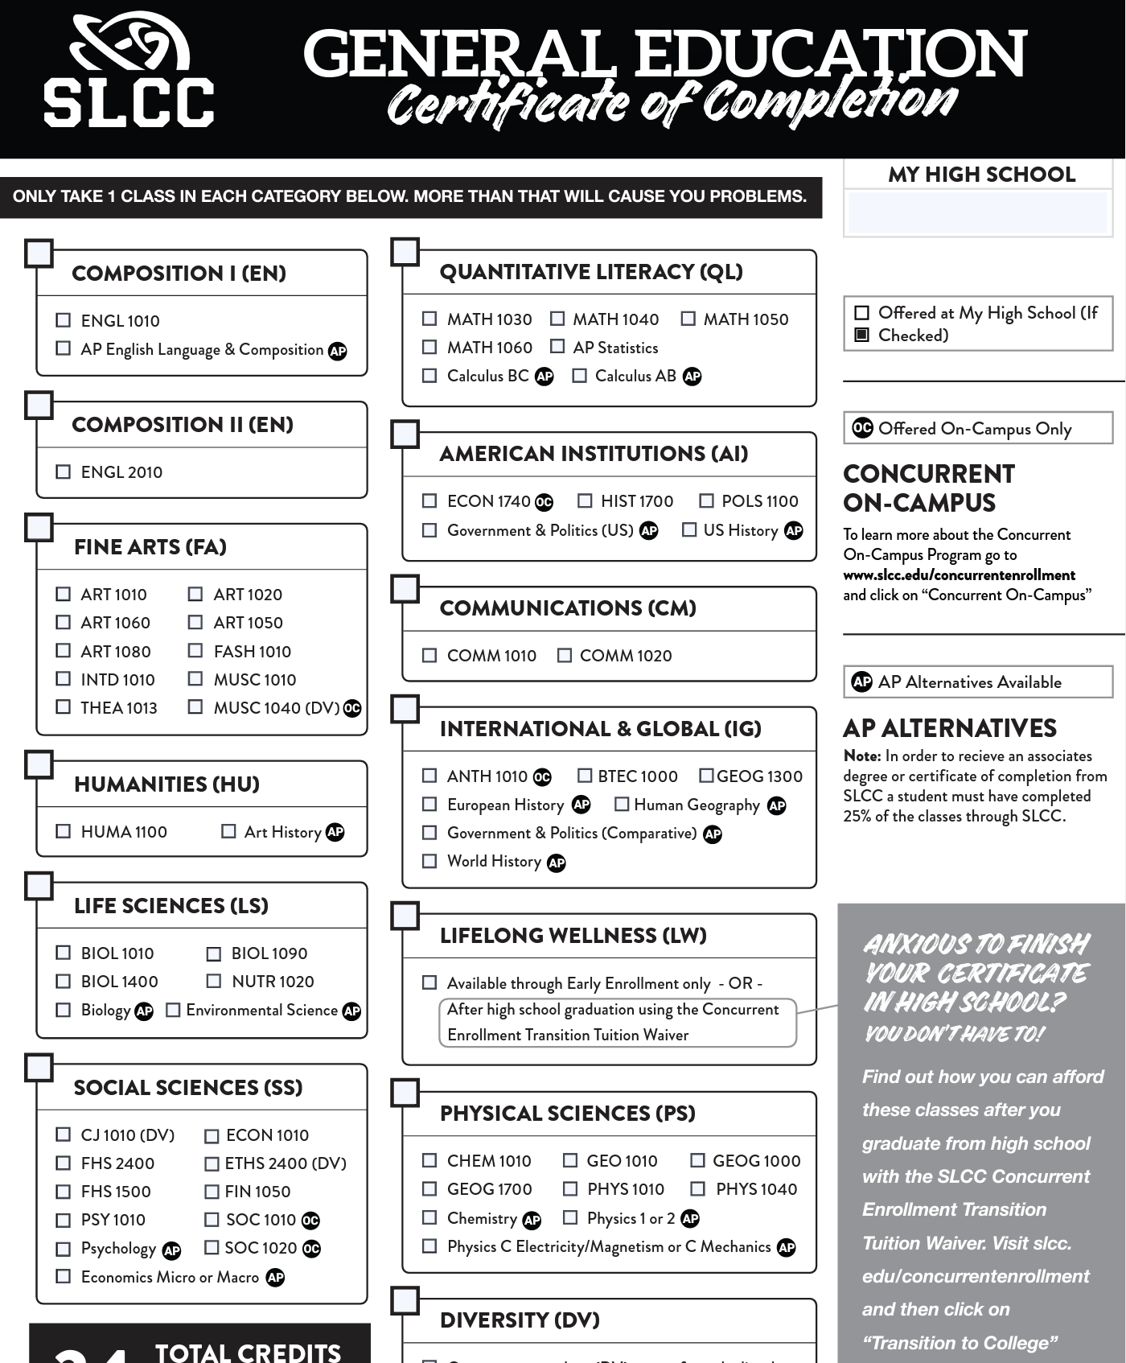
Choosing Courses Wisely

Slide 16
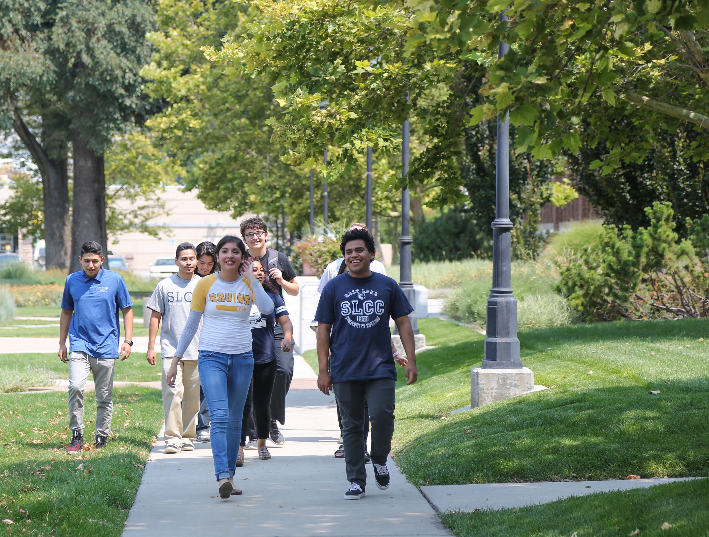
Advice From Students on How to Be Successful in CE

Slide 17


Slide 18


Slide 19


Slide 20


Slide 21


Slide 22

For Parents & Guardians

Slide 23


Slide 24
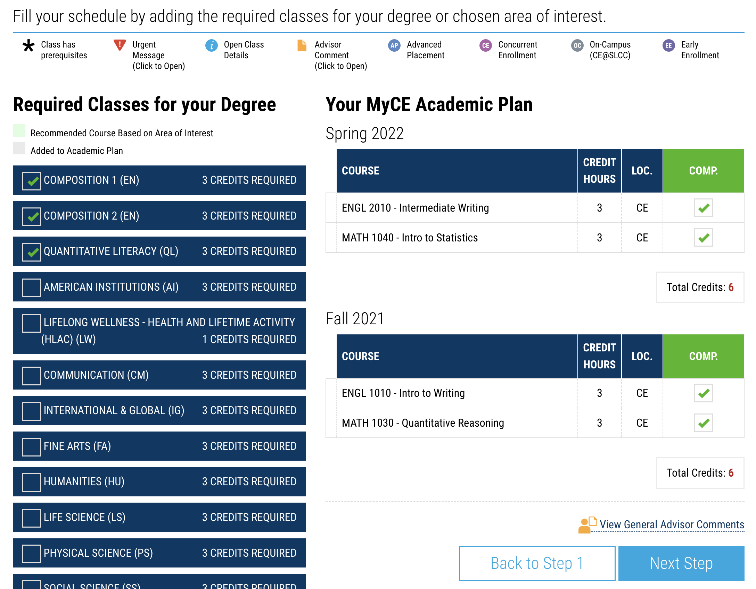
Semester #2 – Take CE to the Next Level

Slide 25

To Find Out More & Get Started
Heading
Contact
[CONTACT INFO]
Body
Notes:
Add the contact information for the main concurrent enrollment contact at your high school.
Resource Recommendation:
For SLCC CE advisor contact info visit: http://www.slcc.edu/concurrentenrollment/Students/advisors.html

