Slide 1


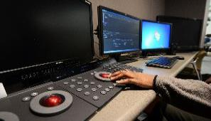
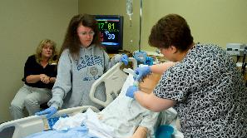
SLCC Higher Education Appropriation Subcommittee Presentation 2014

Slide 2
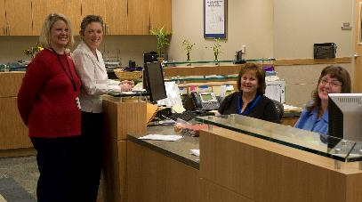


Compensation
3% Compensation
9.5% Health & Dental Insurance Increases
State retirement increases

Slide 3
SLCC Enrollment Projection Growth to 2020

Slide 4
Decrease of 20% in Tax Funds per FTE since 2008
Percentage Change Full-Time Enrollment
vs.
Tax Funds per FTE

Slide 5
National Center for Higher Education
Management Systems (NCHEMS)
E&G Line Item
$65.6 Million

Slide 6
2014 Equity Funding
USHE System Request
Salt Lake Community College $21,714,900
$21.7M
Mission Based Equity
Funding FY 2015

Slide 7


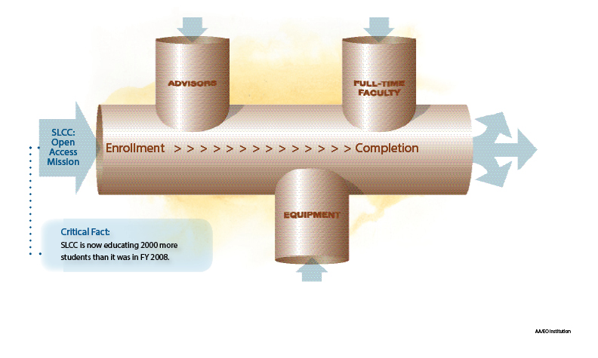





Completion: Keeping the Pipeline Flowing
SLCC is the top producer of students
who transfer to four-year
institutions in Utah
Student
Support
Instruction
SLCC has been in the top ten in the nation in number of graduates for the past 10 years.
Infrastructure
SLCC-trained workers are meeting the needs of industry partners

Slide 8


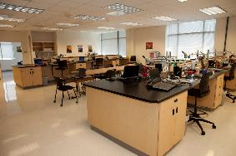


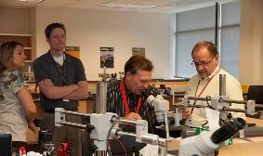
Instruction
Student Support
Infrastructure

Slide 9
Acute Equity
Instructional Support
Implementation of full-time faculty rank structure
New full-time faculty for high demand Gen Ed and CTE courses
General support for workforce and economic development operations
Ongoing support for new programs such as Visual Arts, Design and Health Information Technology
Institution and program accreditation costs

Slide 10
Acute Equity
Student Support
Current student to advisor ratio 1222:1
Campus and site support
Additional staff support in student service programs (i.e. financial aid, admissions, orientation, student outreach)
Conversion of soft funded positions to E&G support to minimize/decrease student fee increases in the future
Ongoing funding to support student employment opportunities

Slide 11
Acute Equity
Infrastructure Support
Personnel
  Funding for key new positions
  Full time legal counsel, Facilities, IT, HR,
  Emergency management personnel and operations support
Equipment (New & Replacement)
    Instructional
    IT hardware, wireless, computers
    Facilities management equipment

Slide 12
Acute Equity
Infrastructure Support
Facilities
    Acceleration of Debt Service Payments
    Renovation Projects
Operating Budget Adjustments
    IT Hardware and Software Costs
    Institutional Leases and facility maintenance

Slide 13
Mission Based Funding: Distinctive
Student Advising Pathway
College Transition
High School / Adult
Front Door of the College
0 – 15 Credits
Undecided Major Exploration
16 – 30 Credits
Program Advising
16 – 44 Credits
Graduation Transition
45 – 63 Credits
High School Transition
FYE Advisors
Career Advisors
Program Advisors
Completion Advisors
3.5
1
1
1
Current
ETS 7-12
Gear Up 9-12
Horizonte
Grant Funded
SAT?
Momentum
Strategies
College Advisor in
Key Schools
College Readiness
Expanded Summer
Bridge
Increased Attention
to Returning Adult
Transitions
Core-Group Advisors
Working with Gateway
Courses
Mandatory Advising if
Undecided at 30 Credits
Career Module
Additional Program
Advisors
Science / Math
Social Science
CTE
Next Step Advisors
Outreach to Students
for Early Audit
Pipeline Events
Reverse Transfer
Advisor
BLOCK
Need
3 High School Advisors
2 Adult Transitions
1 Early Alert Advisor
1 Career Advisor
5 Advisors
5 FYE Advisors
3 Program Advisors
$325,000
$325,000
$130,000
$195,000
$975,000 Staff
$193,800 Current Expense
$1,168,000 TOTAL

Slide 14
State Initiatives
Student Access Support and Completion
Student Access Support and Completion Budget Request $3,430,000

Slide 15

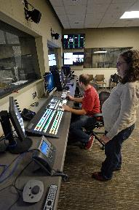
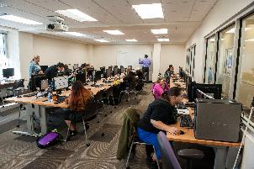


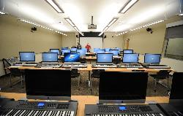
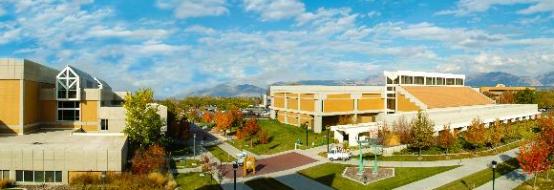

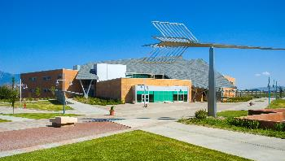
Thank You

