Slide 1

The Legislative Process and SLCC

Slide 2

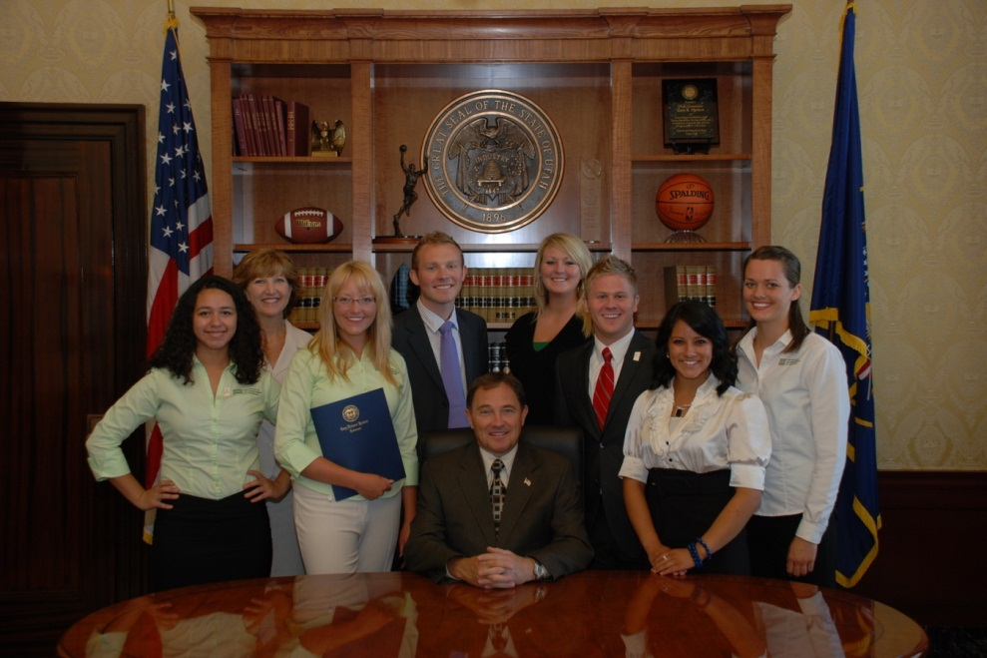
Utah Government
Executive Branch
Governor oversees the Executive Branch, is the CEO of the State.
  Proposes budget
  Signs or vetoes laws

Slide 3
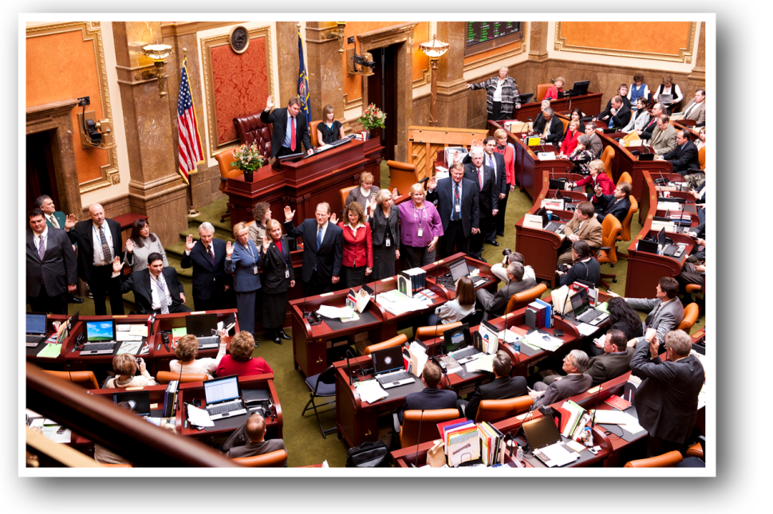
Utah Government-Legislative Branch
Senate
    29 members
    Serve 4 years
    The “deliberative” body
House
    75 members
    Serve 2 years
    Vox Populi (voice of the people)

Slide 4
Legislative Session
What Happens During Session that affects SLCC?
  Legislature meets annually for 45 days (begins Jan. 28)
  Bills considered on a wide range of issues (Tenure, public safety, human resources, procurement)
  Final state budget is adopted for the year; Appropriations bills that determine how much funding the College will receive from state resources

Slide 5
How is Higher Education Funded?
Three primary sources
  State Tax Funds
  Tuition Revenue
  Other Sources
General Sales Tax
Income Tax
1st and 2nd
Tier-Tuition Rates
Grants & Contracts
Sales & Services Student Fees
Auxiliary Revenue

Slide 6
Salt Lake Community College
Historical Tax Funds Appropriation

Slide 7
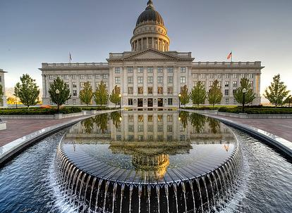
Requesting New Funds
Budget Request Process:
Legislative & Regent Process
Tuition Increase Process

Slide 8
Legislative & Regent Process
July - December
UU
USU
WSU
SUU
SC
DSC
UVU
SLCC
July – August
COP
OCHE
Board
of
Regents
August - September
Governor
(Governor’s Office
of Planning
and Budget)
November
Legislature
(Legislative
Fiscal Analyst)
December
Executive
Appropriations
Committee

Slide 9
Legislative & Regent Process
January - June
Higher Ed.
Approp. Sub.
Regents
January -February
LFA
Institutions
GOPB
Executive
Appropriations
Late February
Legislature
March
Governor
Regents/
OCHE
Tuition
Implementation
Guidelines
Late March
April
April - June
UU
USU
WSU
SUU
SC
DSC
UVU
SLCC

Slide 10

Tuition Increase Process
Statute requires that the Board of Regents reports the required tuition rates to the Legislature for both resident and non-resident students to implement the Board’s budget request.

Slide 11
First-Tier Tuition Increase
Historically established in September with Regents’ budget request
Uniform for all USHE institutions
Included in legislative appropriations bill

Slide 12
Second-Tier Tuition Increase
Initiated in the 2001-02 academic year
Optional increases recommended by a president with approval from the Board of Trustees:
  Requires consultation with students and public hearings
Must be adopted by the Regents
Excluded from legislative appropriations process for the first year:
  Institutions retain authority to allocate funds consistent with agreement with students
  Second-tier tuition is then included in the “base” state-appropriated budget

Slide 13
Changes in Tuition Levels
Total funding per student has decreased $600

Slide 14
USHE 2013 Legislative Priorities
Compensation
Same state funded salary and benefits increase provided to all other state and public education employees
Higher Education funds 25% of increase
For Example:
  State portion (75%) of 1% increase: ~$7 mil.
  State portion of 1% benefits increase: ~$900k
USHE competes regionally and nationally for talent

Slide 15
USHE 2013 Legislative Priorities
Mission-Based Performance Funding
Two of four priorities requested:
Distinctive Mission $8 million
(Participation, Completion, Economic Development)
Equity $8 million
Target 55-70% of state funds based on mission developed by NCHEMS
Addresses inequities in funding mix—tuition vs. tax dollars
New Enrollment Growth not requested
Historic Unfunded Growth ($70 million) not requested

Slide 16
USHE 2013 Legislative Priorities
Expand Teaching Capacity and Completions by 2020
By 2020, 66% of jobs in Utah will require post-secondary education
Currently, only 43% of Utah’s adults hold a higher education degree or certificate
We must increase degrees & certificates awarded by 4% each year to reach 66% by 2020
This is the first step to create a highly-educated workforce

Slide 17
USHE 2013 Legislative Priorities
4) Operational Imperatives $10,446,000
Ongoing O&M for Non-State funded projects $4,396,000
  University of Utah
  Utah State University
  Weber State University
U of U Utility Rates $3,900,000
Higher Ed. Tech. Initiative (HETI) $2,150,000
  Leverages combined volume purchasing
  power of all institutions for IT purchases

Slide 18
USHE 2013 Legislative Priorities
5) USHE Programs $2,950,000
Student Access
Success Stipends: (need based financial aid): $2 million
  work-study & grants (average award: $850/student)
Regents and New Century Scholarships: $500,000
  Projected ~25% growth
Tech. Intensive Concurrent Enrollment: $150,000
  Ongoing course maintenance, consultation,
  articulation, transfer
Collaborations
Utah Academic Library Consortium $300,000
  Database acquisition for use by all institutions

Slide 19
USHE 2013 Legislative Priorities
6) State Initiatives $14 million
University of Utah Medical School Expansion $10 million
  To increase class by 40 students per year (160 total)
  $62,500/student/year (typical national cost: $100-110k)
  1,500 applicants for 82 slots last year
  To help address Utah’s primary care physician shortage
  $3.5 million one-time reduction in first year
Dixie State College – University Implementation $4 million
  Assuming Regents approve mission change
  Expected to meet agreed upon benchmarks by end of 2012
  Will help implement new mission
  To enhance capacity, including technology

Slide 20
USHE 2013 Legislative Priorities
7) One-time Increases $1,750,000
Higher Education Technology Initiative (HETI) $750,000
USHE purchase of security software and ongoing license/maintenance
Utah Academic Library Consortium (UALC) $300,000
Training for digital preservation of historical materials
Tech. Intensive Concurrent Enrollment (TICE) $600,000
Implement last 7 courses for General Education at USHE institutions
Full delivery planned for Fall 2014
Utah Women and Education Initiative (UWEI) $100,000
Implementing recommendations of Utah Women’s College Task Force

Slide 21
SLCC 2013 Legislative Priorities
Compensation
Equity Funding

Slide 22
SLCC 2013 Legislative Priorities
3. Mission Based Funding – SLCC Student Analytics
Description – SLCC will build a comprehensive student data hub and increase its capacity to use student analytics to positively impact the progress of students and improve institutional processes that support student success. Components of the project include:
Provide infrastructure (integrated data bases, data structures, data warehouse, and analytic capabilities) to support a student success network
Improve internal data sharing through dashboards, reporting and analysis
Develop a framework for timely intervention “flags” directed to students, faculty and staff to enable targeted support for at risk students
Track the effectiveness of our student interventions
Provide technical training and support for faculty and staff in use of student analytics to impact student success
Develop a deeper understanding of our students’ educational and career outcomes through longitudinal tracking

Slide 23
Key SLCC Messages
2013 Legislative Session
Higher Education Employees should receive a compensation increase, and it should be no less than any increased received by other state employees
While additional state funds for equity and mission-based funding were a step in the right direction in this last legislative session, additional funding is still needed for the College it carry out its mission. In particular, the state must continue to address the issue of equity in funding. Nationally states subsidize 70% of the cost of education for community college students. In Utah the state subsidy is only 50%, creating economic barriers of entry for too many students looking to the College as their starting point for higher education.

Slide 24
Key SLCC Messages
2013 Legislative Session
Funding for higher education must become a higher priority in Utah if the state is to achieve its goal of having 66% of Utah adults earn some form of post-secondary education credential by 2020.
SLCC is uniquely positioned to play a significant role in helping achieve that goal, given its role in educating high school students through concurrent enrollment, awarding industry-based certificates and associate’s degrees, and providing transfer education opportunities for the largest number of students in the system. The College must have the financial resources needed to carry out this critical component of the plan.

Slide 25
Key SLCC Messages
2013 Legislative Session
Salt Lake Community College remains committed to its mission as the state’s only comprehensive community college, providing quality higher education and lifelong learning to people of diverse cultures, abilities, and ages.
The College is continually assessing and working to meet the needs of community and government agencies, business, industry and other employers. The partnerships with L-3, Goldman Sachs and Habitat for Humanity are just some examples of the College’s willingness and ability to recognize and meet those needs.

Slide 26
Key SLCC Messages
2013 Legislative Session
The College is #3 in the nation in associate degrees awarded, and has continually been in the top 5 for the last several years . The College continues to educate and prepare more students to transfer than any other institution in the state.
The College is the largest provider of career and technical education in the state, and continues to take steps to enhance the quality of CTE programs to ensure they are being responsive to the needs of both the industry and students. During the last three years the College has created 33 new and/or industry-responsive CTE programs including electronics instrumentation, biomanufacturing, and mortuary science.

Slide 27
What is the role of the
Vice President of Government Relations in the Legislative Process?
Serve as liaison to Governor’s Office, State Legislators and Staff, representing the President and the College
Develop positive working relationships with elected officials and staff, in and outside session
Monitor and track key legislation and appropriations bills affecting College
Testify before legislative committees

Slide 28
How can you have a part in the legislative process?
Identify your representatives http://le.utah.gov/GIS/findDistrict.jsp
Contact them before the session, not just during the session
Identify yourself as a constituent in correspondence
Attend legislative meetings and hearings

Slide 29
What are the keys to effective advocacy?
Be honest and genuine
Provide factual, accurate information
Put information in context
Make it personal, tell your own story
Avoid mass mailings, emails

