Slide 1
Transformative Tension:
A Hip-Hop Pedagogy for Justice, Equity, Diversity & Inclusion for Community Transformation (JEDI4ST)
Dr. Clifton Sanders, Provost
Dr Anthony Nocella, Assistant Professor, Department of Criminal Justice and Criminology
Dr. Nancy Barrickman, Associate Professor, Biology
Gina Alfred, Student Service Coordinator, Co-Chair Utah Reintegration Project
Dr. Lea Lani Kinikini, Assistant to the President, CDO

Slide 2
JEDI4ST
Justice, Equity, Diversity and Inclusion for Social Transformation (JEDI4ST) founded in the Fall of 2020, is the interdisciplinary research center at SLCC, which is housed in the Chief Diversity Office. Its mission is liberatory social transformation with the goal of ending oppression, inequity, exclusion, and injustice. Social transformation is a change in all aspects of society including the people, institutions, systems, industries, and communities rather than the narrow scope of social change movements that focuses on one or two aspects of society. Our approach is grounded in Paulo Freire’s concept of praxis within critical pedagogy: we interweave theory and practice.
The JEDI4ST Program has two streams:
Scholarship (theory), which includes research projects & publications (e.g., books, articles, and journals), and educational forums (e.g., lectures, debates, conferences, and panels)
Community collaborations (practice), which supports community initiatives and activist organizations that promote justice, equity, and inclusion for disadvantaged and oppressed populations.
We want to be the best community college research center in the U.S. and we want to be the premier critical community engaged research center high education.

Slide 3




Slide 4
Doing Something With Nothing
THAT IS HIP HOP

Slide 5
Justice, Equity, Diversity, and Inclusion - JEDI
Know Where You Come From
Tension is GOOD
It is Us and the System Transformation
Do Not Silence Stories
Don’t Fall for the Gap - Our Journey Can be Different While Our Goal Is The Same
We are the Best
Shout Out

Slide 6
Mission, Vision, and Values
No Where We Come From
Transformative Education is a term fostering out of the work from Women of Color who have been influenced by critical pedagogy, a field founded by the great education theorist Paulo Freire.

Slide 7
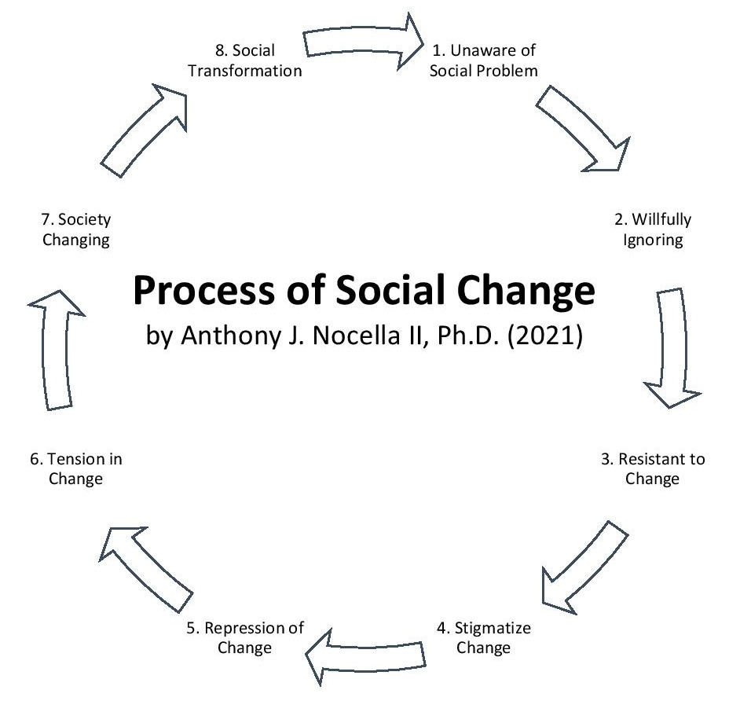

Slide 8
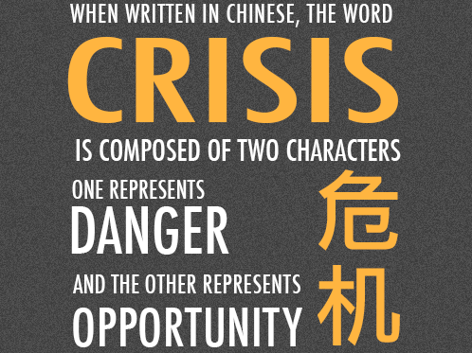

Slide 9

Embrace the Battle and Tension

Slide 10
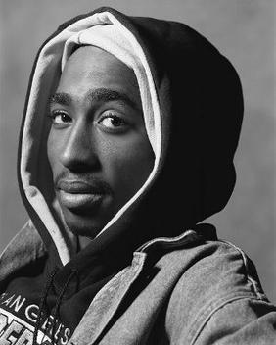
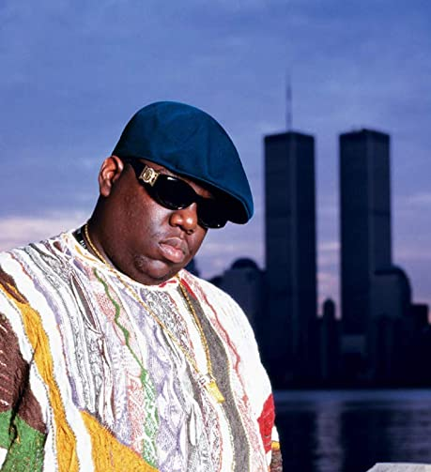
It is about Us and the System
Huggin' on my mama from a jail cell
And who'd think in elementary, hey
I'd see the penitentiary one day?
And running from the police, that's right
Tupac, Dear Mama
Yeah, this album is dedicated
To all the teachers that told me I'd never amount to nothin'
To all the people that lived above the buildings that I was hustlin' in front of
Called the police on me when I was just tryin' to make some money to feed my daughter (it's all good)
- BIGGIE

Slide 11
Marginalized not Minorities
Recognize Oppression Not Less Than
Equity (get what you need) not Equality (do not give everyone the same)

Slide 12
Be You – Meaning Stay in Your Lane
Respect and Acknowledge Other Stories
Support Culturally Relevant Pedagogy
Do Not Fake the Funk
Do not Strive to Support Culturally Competent Pedagogy

Slide 13

Education and Entertainment
Edutainment

Slide 14
The Ends Do Not Justify The Means
We all have different experiences and journeys, which develop different stories.
We have to respect different journeys, while promoting one goal, which is graduation.
To respect different journeys is to respect diversities.
The student’s story does not start with SLCC, we are just honored to continue it with the students.

Slide 15
We are the Best and Love Your Haters
Accessible College
Great Mission, Values, and Vision
Affordable
We have the Best Students, Staff, Administrators, and Faculty
We are grass-roots as we are community

Slide 16
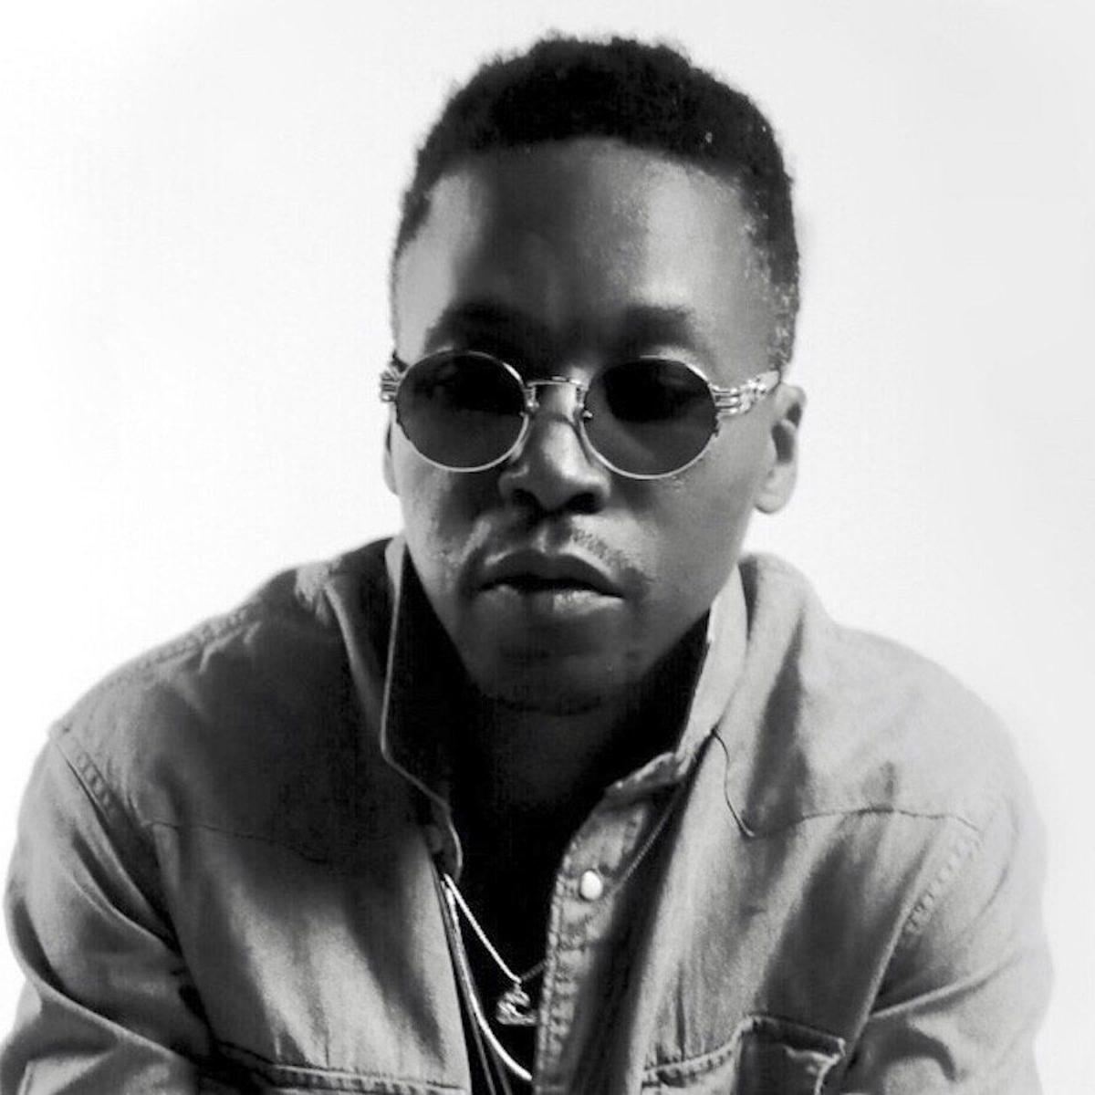
The Show Goes On - Lupe Fiasco
One in the air for the people ain't here
Two in the air for the father that's there
Three in the air for the kids in the ghetto
Four for the kids that don't wanna be there
None for the niggas tryna hold them back
Five in the air for the teachers not scared

Slide 17
Shout Outs

