Slide 1

UoU Executive Leading with Equity, Diversity and Inclusion Certificate
SLCC EDICT, Generation One
Cristobal Villegas, Danielle Susi-Dittmore, Jen Seltzer Stitt, Jerri Harwell, Dr. Juone Kadiri, Dr. Lea Lani Kinikini, Peter Moosman, Gina C Alfred

Slide 2

The Leading With Equity, Diversity, and Inclusion Certificate is twelve weeks in length and covers the following seven courses
Diversity, Inclusion, and High Performance
Diversity Legal Requirements: Know Your Legal Rights and Duties
Leading Across Generations: Understanding Diverse Generational Values
Leveraging Psychological Safety to Create a Growth-Mindset Organization
Managing Diversity and Inclusion: Developing a Systemic Organizational Model
Rethink: Understanding your Unconscious Bias
The Racial Crisis in America

Slide 3
Tasked with gathering, processing, and analyzing Equity, Diversity, & Inclusion practices within the College, by using a critical theory praxis.
Orthodoxy vs Orthopraxy
Equality is not equity
Diversity is inevitable
Inclusion is not oppressive

Slide 4

C.I.A
Challenging, Influencing, Actionable

Slide 5

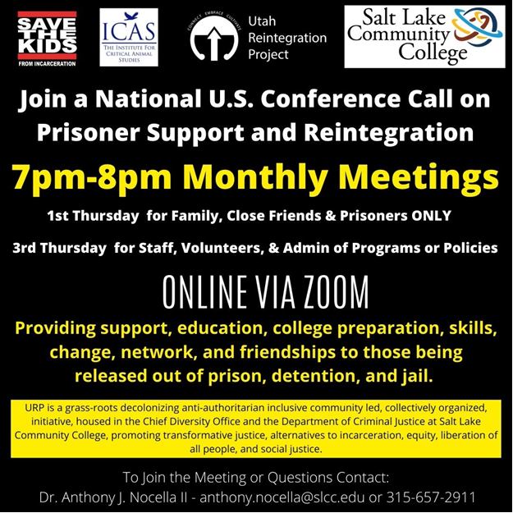
Utah Reintegration
Project

